Slide 1
Python Fact!!
Python was not named after a snake.
It was named after a famous
Comedy shows on BBC
“Monty Python’s Flying Circus”
Source:- “Trust me bro.”
Oh I mean “docs.python.org”

Slide 2
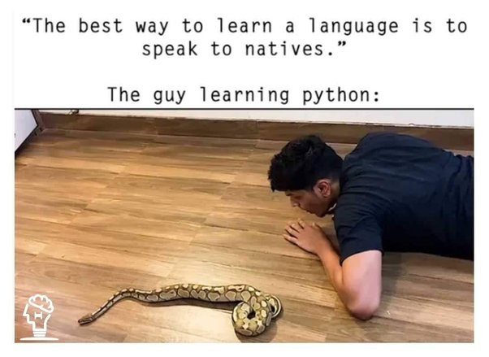

Slide 3
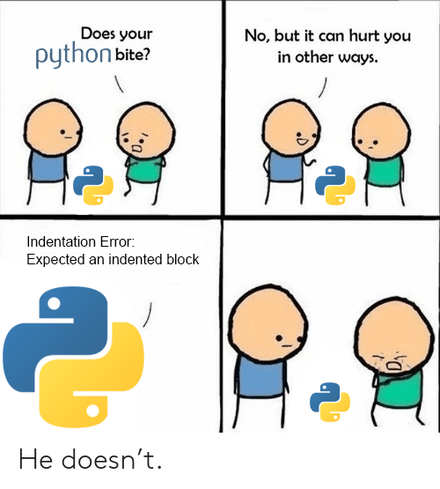

Slide 4
Python Fact!!
Python has different Variant:
CPython
Jython
IronPython
Brython
RubyPython
PyPy
MicroPython

Slide 5
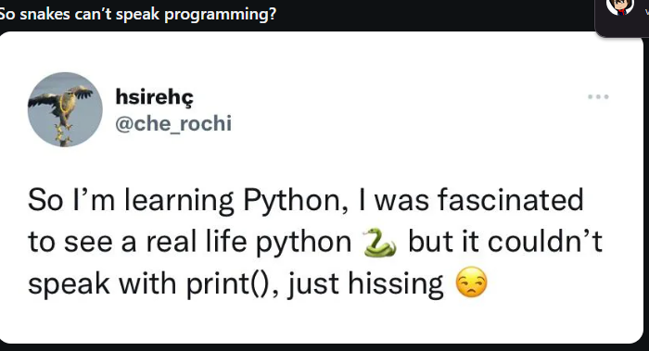

Peepo
@Peepo_TWC

Slide 6
Python Fact!!
Python Has One of the Largest Community Support
Python has one of the largest community support systems in the programming world. The vast network of Python users consists of people from various platforms. There are many online tutorials, notes, and resources available for free. It makes it easier for new programmers to learn from the best resources.
The vast community also offers help whenever someone is struggling with doubt. They also contribute to open-source projects. This extensive support makes sure that people everywhere can find proper assistance, share ideas, and collaborate openly on projects.

Slide 7


Slide 8
Python Fact!!
Python was created as a hobby project
Believe it or not, Guido van Rossum started working on Python in 1989 because his office was closed for the Christmas break and he was feeling bored at home. At the time, Guido was working at the Centrum Wiskunde & Informatica (CWI) in the Netherlands. At CWI he was using the ABC programming language but found that it was lacking in some aspects. So, he decided to create a language that would be user-friendly and would fix the issues he had found in ABC. Guido drew inspiration from various programming languages, but he also gave life to his own ideas and took into account his personal preferences.

Slide 9
Python Fact!!
You know there is an easter egg in Python
Well someone wrote a poem. And you can read it from Python. All you have to do is type
import this
And run the program, this will print that poem in the terminal.. Try it!
If you have created 2 or 3 complete projects, you will surely relate to this
Its just a good easter egg.

